Slide 1
Clustering Paris and Marseille districts: restaurant location
Wojciech Stach
January 5, 2020

Slide 2
Outline
Background
Problem Statement
Data
Methods
Results
Conclusions

Slide 3
Background
Business location can have huge impact on profitability
Especially important for restaurants as customers often use proximity as a very important factor in making decisions where to eat
Knowledge of neighborhoods is essential to shape menu and service to meet clients’ needs
This project focuses on two largest cities in France: Paris and Marseille
20 districts (arrondissements) in Paris
16 districts (arrondissements) in Marseille

Slide 4
Problem Statement and Audience
Problem
Perform districts analysis in Paris and Marseille to identify similar and dissimilar districts in terms of types of venues
Audience
New/future business owners
to help finding a good district for their business
to choose the restaurant type and menu that best address the clients’ needs
Existing business owners
To help choosing location when expanding or moving their business to a different location

Slide 5
Data
The following datasets were used
https://public.opendatasoft.com/explore/dataset/arrondissements-millesimes0/table/
Data for 20 districts in Paris and 16 districts in Marseille
names
longitude and latitude
https://developer.foursquare.com/
community-based venues data

Slide 6
Methods
K-means clustering
Paris districts
Marseille districts
Paris & Marseille districts together
Elbow method to find optimal number of clusters for each case
Mark clusters on maps
Find common characteristics of districts from the same clusters

Slide 7
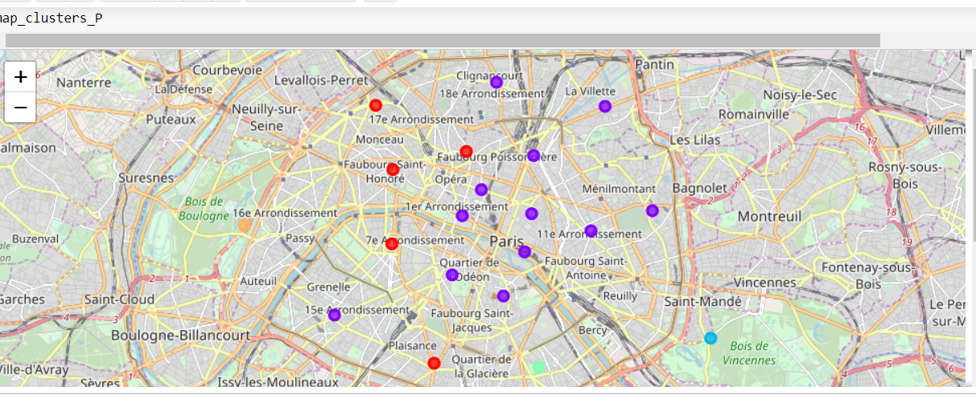
Results - Paris
Cluster 0 - red: Central-West districts of Paris (major venues: French restaurants and hotels)
Cluster 1 - purple: Central-East districts of Paris and 15th district (that is in the West of Paris). Similar profile to Central-East district except for non-French restaurants showing quite high in terms of most popular venues
Cluster 2 - blue: residential districts. Main venues include markets, stores, zoo
Cluster 3 - green: multicultural districts, specifically including lots of Asian restaurants
Cluster 4 - orange: upscale districts. Main venues include plaza, pool, lake.

Slide 8
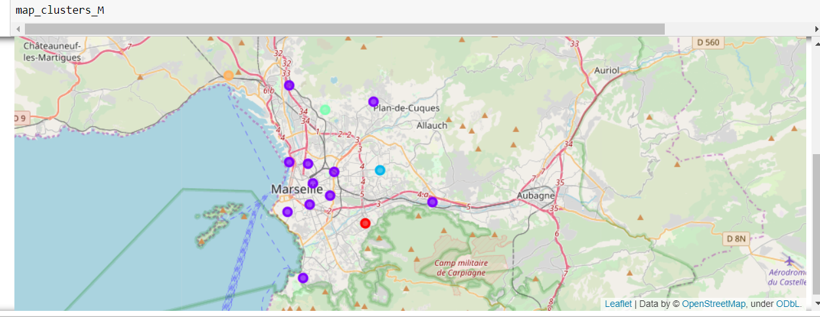
Results - Marseille
- Cluster 1 - purple: Center area of Marseille. Most popular venues include hotels and restaurants. Interestingly, districts 8th, 11th , 13th , and 15th that are further from the center of Marseille are in this cluster, too
- Clusters 0, 2, 3, 4 – other colors: Other venues are more popular, including shops tram stations, etc. More knowledge about the city is necessary to provide better distinctions between these clusters

Slide 9
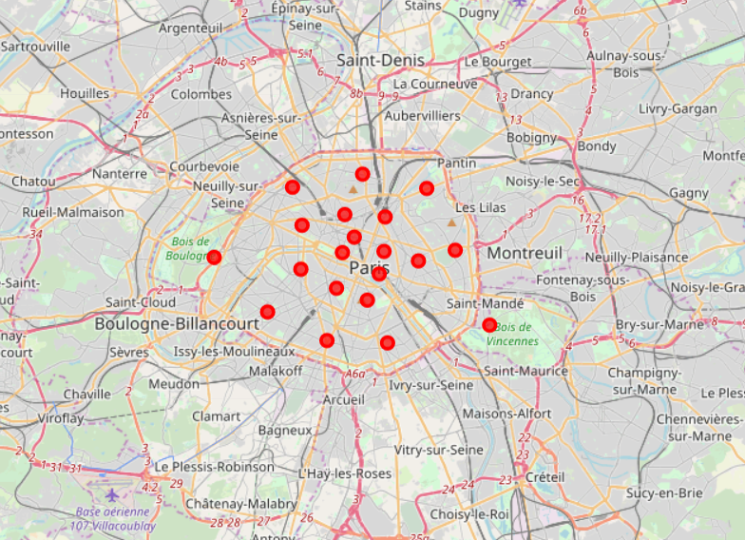
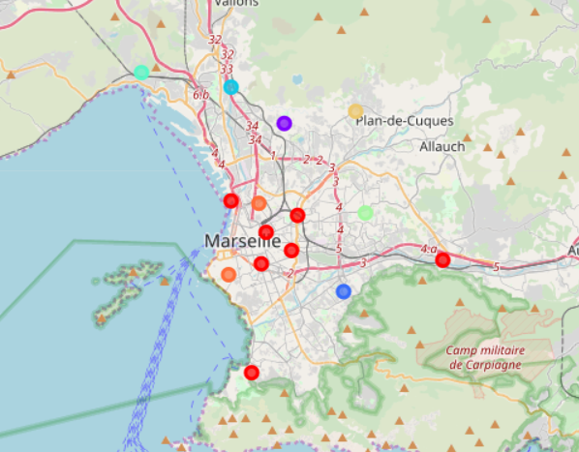
Results – combined Paris (left) & Marseille (right)
Cluster 0 - red: Includes all districts from Paris and seven districts from Marseille (all of them from cluster 1 in Marseille clustering). This suggests that all Paris districts are quite like each other when compared to Marseille districts
Clusters 1-7: Outskirts of Marseille. More knowledge about the city is necessary to provide better distinctions between these clusters

Slide 10
Conclusions and Future Work
Clustering is capable of grouping districts based on multiple features
Paris clusters match intuitive classification of central districts vs. outskirts
Interestingly, the 15th district show more similarities to the central districts
Marseille clusters show similar clustering in terms of central districts
8th,11th, 13th, and 15th districts are more similar to the central districts despite being geographically closer to the outskirts
Paris and Marseille clusters show that Paris clusters are very similar to each other when compared with Marseille
It would be very beneficial to have a local expert to provide more insights and explanations of the clustering results
The clustering analyses can be helpful in making decisions about choosing the location for a restaurant
Looking at the most popular venues and similar districts can provide interesting information
Future work may include adding population, socio-economic as well as demographic data to provide more comprehensive analysis

